Slide 1
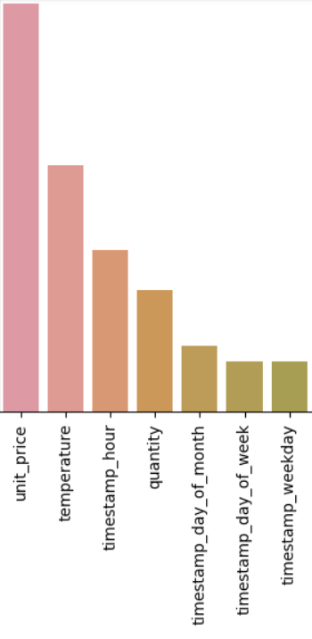
RELATIVE FEATURE IMPORTANCE
Model Performance:
Mean Absolute error obtained from the model is : 0.24 which is very low.
Limitation and Next Steps:
we can report to the business with the findings and recommend
to add more features and data to get good prediction.
Summary:
Utilizing the trained model, we can analyze the feature importance
that played a significance role in predicting the target variable.

